Slide 1
Gym data analytics for business in Toronto, York area

Slide 2
Predicting the new gym location is valuable.
population figure for Toronto, the York Region in 2019 is 1,191,400
It is constantly growing for the last several years averaging 1.9 percent per year since 2011
there are not enough gyms in that region

Slide 3
Data acquisition and cleaning
list of postal codes, Wikipedia data source
latitude and longitude of each neighbourhood, Latitude and Longitude
Cleaned data contains 103 rows and 5 features
York area contains 34 rows and 5 features

Slide 4
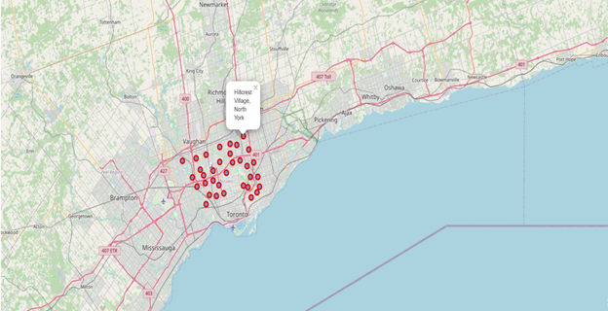
Geospatial visual analysis

Slide 5
Neighbourhoods exploration
336 venues with 120 unique categories within a 500-meter radius
Check to verify it contains Gym venue
Calculate mean for each venue

Slide 6
Cluster Neighborhoods
Unsupervised machine learning algorithm
Clustering method by using k-means clustering
Cluster York area neighbourhoods into three clusters

Slide 7
Cluster Neighborhoods
Unsupervised machine learning algorithm
Clustering method by using k-means clustering
Cluster York area neighbourhoods into three clusters

Slide 8
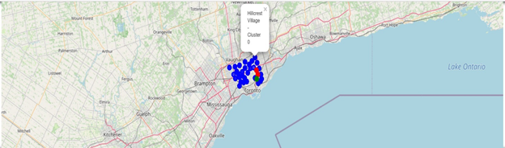
Clusters map

Slide 9
Conclusion and future direction
Parkview Hill, Woodbine Gardens might be a good location to open a gym
only one factor, existence, was taken into consideration
future research should take into consideration additional factors

